Slide 1
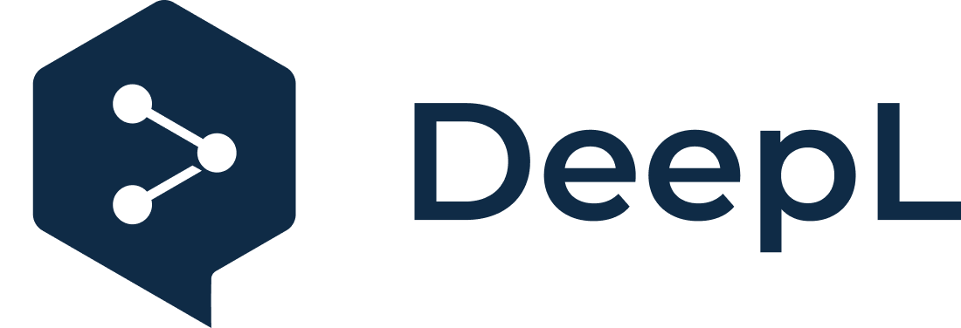
Subscribe to DeepL Pro to edit this document.
Visit www.DeepL.com/pro for more information.

Slide 2
INTELLIGENCE AS A SERVICE. SELF-MANAGEMENT OF SERVICES
Intelligent infrastructure design for the IoT (DII)
(Second Part)
Alfonso González Briones
Based on material created by Jorge Gómez Sanz

Slide 3
Introduction SaaS and Serverless
PaaS for IoT
Azure + IoT Edge: adds Edge computing capabilities. Allows code to be deployed to run there.
Azure Digital Twins, manage digital twins, https://www.youtube.com/watch?v=AtYEpvnEpp0
Others
Apache kafka, real time data processing. https://kafka.apache.org
Apache spark, off-line data processing. https://spark.apache.org/

Slide 4
Introduction SaaS and Serverless
Introduction to SaaS
SaaS or Software as a Service is another cloud paradigm where the idea is that the software you need is not on your premises.
You rely on others to maintain this software and become a remote customer.
Much like the old business model of the 70's before PC's.
Gartner - https://gcom.pdodev.aws.gartner.com/en/newsroom
[2012] - "Gartner says organizations are more likely to use SaaS for sensitive data than for mission-critical data."
[2014] - "Gartner survey reveals SaaS deployments are now mission critical."
Cost reduction... yes; operational agility... also

Slide 5
Introduction SaaS and Serverless
What about IoT?
Azure: + IoT Central, connect and manage your IoT devices, https://docs.microsoft.com/en-us/azure/iot-central/ + IoT Hub, communication hub for IoT, https://azure.microsoft.com/en-us/services/iot-hub/
IBM: + Internet of Things Platform, https://console.bluemix.net/catalog/services/internet-of-things-platform + AT&T Flow Designer, design IoT solutions with graphics + Bosch IoT Rollouts, update device firmware + Car diagnostic API, to read and interpret OBD codes + Precision location, using WIFI, gps, cellular or hybrid location + Unification Engine, an IoT messaging platform covering SMS, email, whatsapp to connect human and devices using NLP
OpenSource + thingsboard: https://thingsboard.io/; https://github.com/thingsboard + FIWARE: https://www.fiware.org/successstories/smartappcity; https://github.com/Fiware + AEROGEAR: https://aerogear.org/
Not so open source + OneSignal: https://onesignal.com/; https://github.com/OneSignal/ + Circuit: https://www.circuito.io + Makecode: https://makecode.adafruit.com/; https://www.microsoft.com/en-us/makecode

Slide 6
Introduction PaaS and IaaS
You have already used a cloud service that consists of creating a Virtual Machine in Azure. Exercise:
Start the Azure virtual machine
Open a console
The "last reboot" command indicates how long the server has been running.

Slide 7
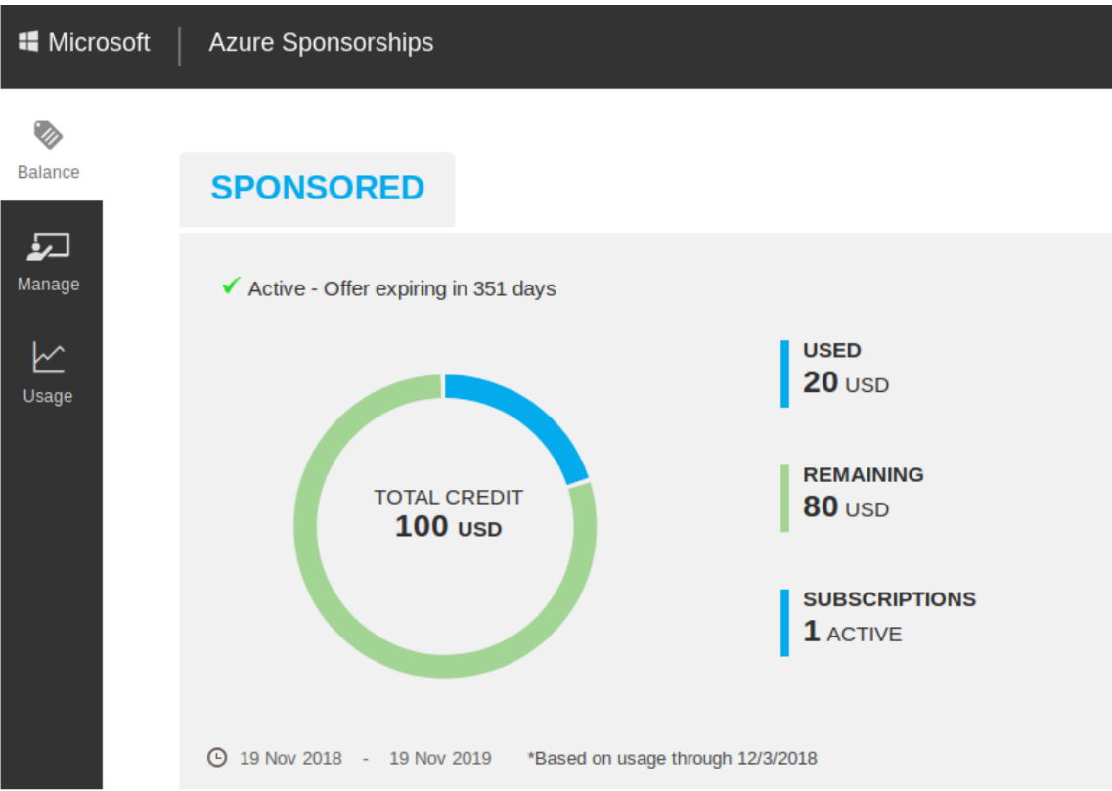
Introduction PaaS and IaaS
Then go to https://www.microsoftazuresponsorships.com and choose "check your ballance".

Slide 8
Introduction PaaS and IaaS
Within the same site, go to "usage" on the left and download the usage statistics.
You pay money to have the machine even without running it because you are taking up space. Use only what you need.

Slide 9
Introduction PaaS and IaaS
What can I do to use cloud services more efficiently?
Three options:
IaaS: based on virtualization technology. Running virtual machines as guests in a data center.
PaaS: you get a platform on which applications are delivered.
SaaS: the software is obtained directly through the web.
A fourth: no server. It's the lamda (AWS) or functions (Azure).(https://www.ibm.com/cloud/learn/iaas-paas-saas)[https://www.ibm.com/cloud/learn/iaas-paas-saas ]

Slide 10
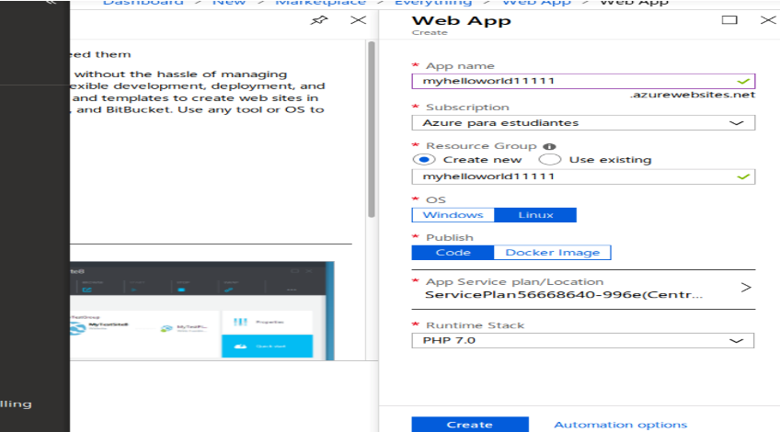
Introduction PaaS and IaaS
Example of PaaS with Azure
Create a resource and search for "web app". Select the "Web App" option and click "create".
Search for an unused web application name.
Green check:

Slide 11
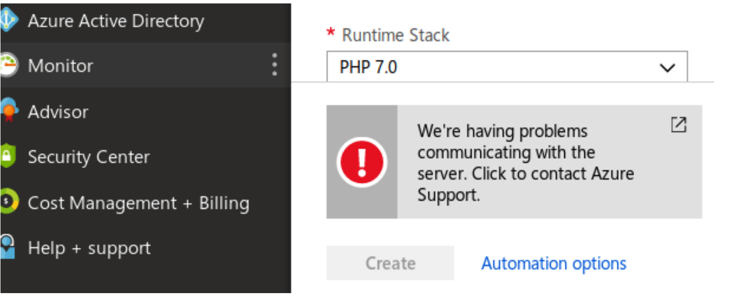
Introduction PaaS and IaaS
Example of PaaS with Azure
If you see this problem, which requires contacting, ignore it and try again later.

Slide 12
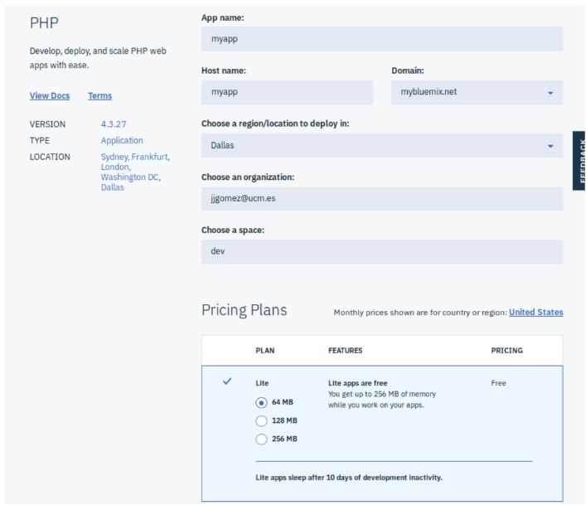
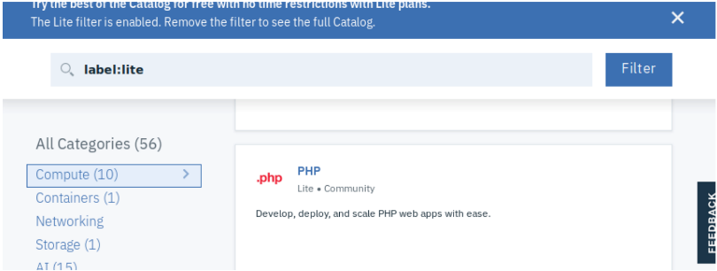
Introduction PaaS and IaaS
PaaS with IBM Cloud example
Register at https://developer.ibm.com/academic/
Enter the application panel https://console.bluemix.net/dashboard/apps/ and select "Create Resource". Choose Compute and Php
Choose app name and pricing plan

Slide 13
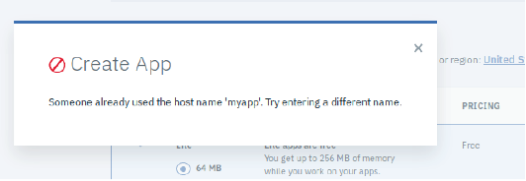
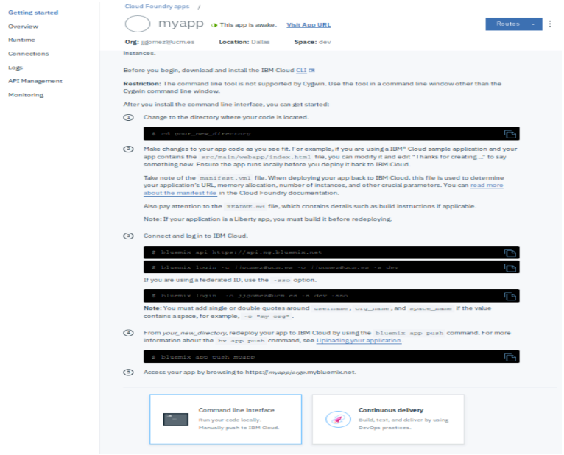
Introduction PaaS and IaaS
PaaS with IBM Cloud example
If the host name is chosen (it must be unique), then this message will appear and must be changed.
IBM asks for the IBM Cloud command line interface to be installed and instructs if you want to update the code.
If not, access the url of the app:

Slide 14
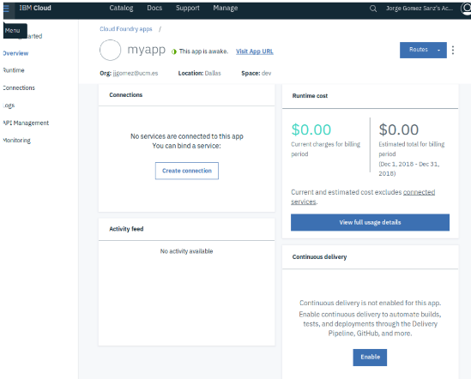
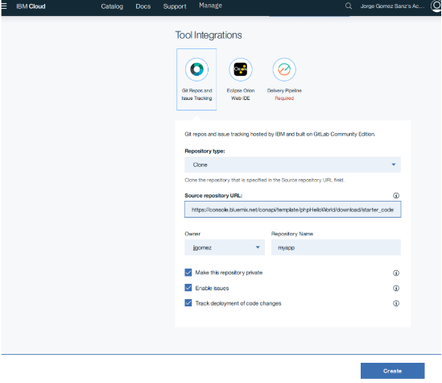
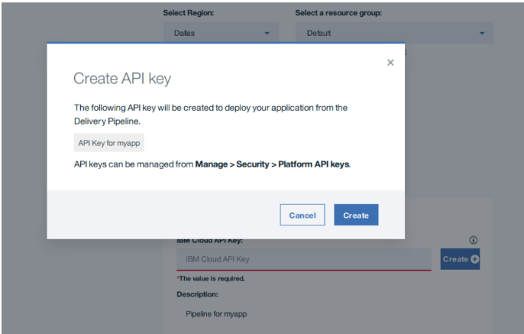
Introduction PaaS and IaaS
APP development with IBM Cloud
Once the application is deployed and a name is assigned to it, it is necessary to upload the changes. 2 options:
Using the IBM Cloud CLI (you need to install it on your computer)
Using a tool chain and connecting the application to a git repo
In the example above, click on "continuous delivery" and then on "creating a toolchain from an app". The tutorial indicates how to create a toolchain, how to assign the toolchain to an app. This is a summary:
With the application, click on summary and then "enable" continuous delivery (bottom right).
Then click Create one.
in create

Slide 15
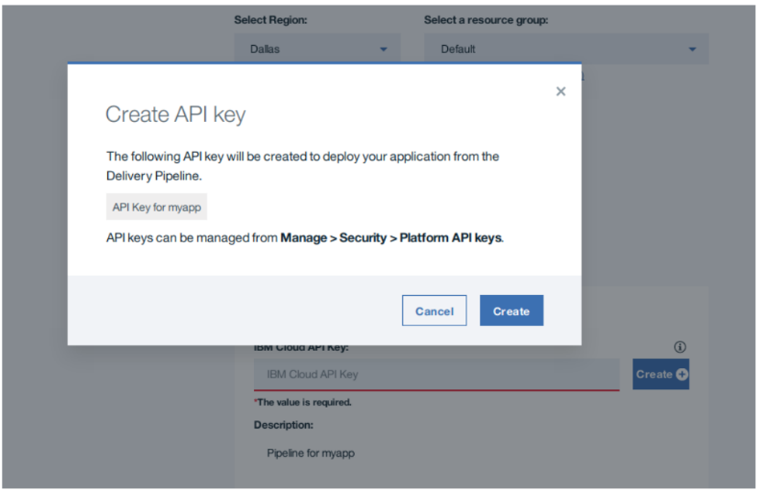
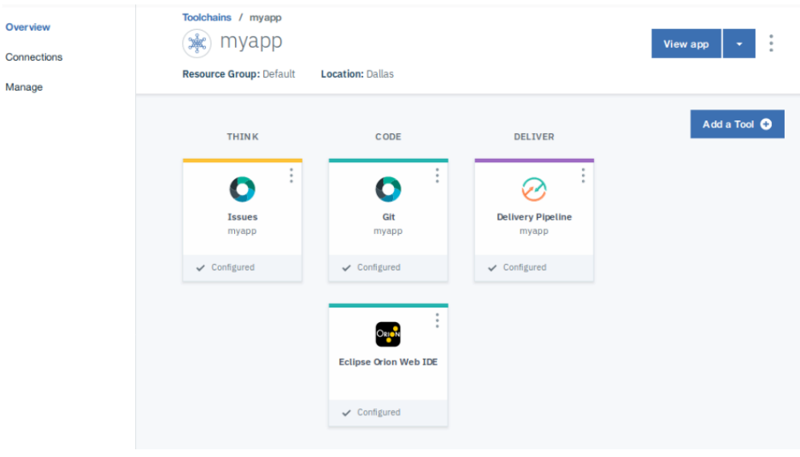
Introduction PaaS and IaaS
APP development with IBM Cloud
Test again. When finished, you will have a repo, a SaaS with Eclipse Orion...

Slide 16
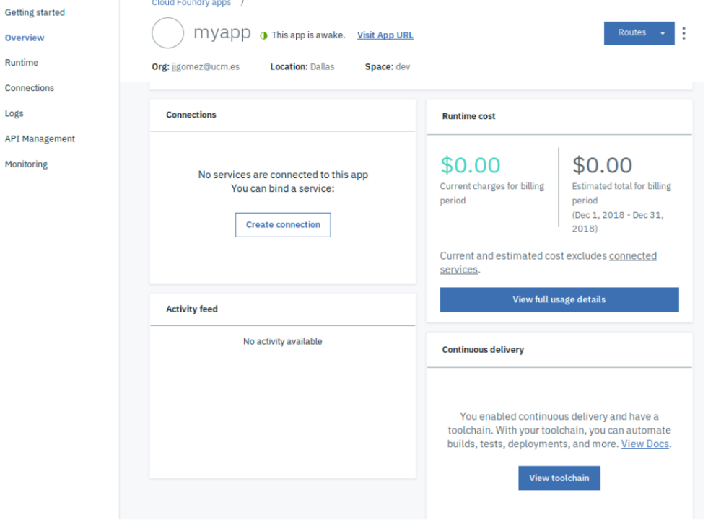
Introduction PaaS and IaaS
APP development with IBM Cloud
You can access the toolchain again from the application script.
From here you can do whatever you want:
Use Eclipse orion to access the file and edit it
Clone the repo locally and drive the changes

Slide 17
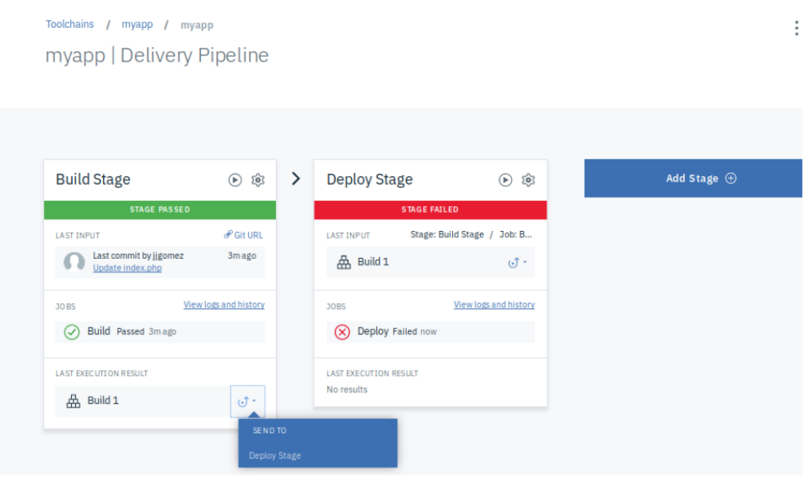
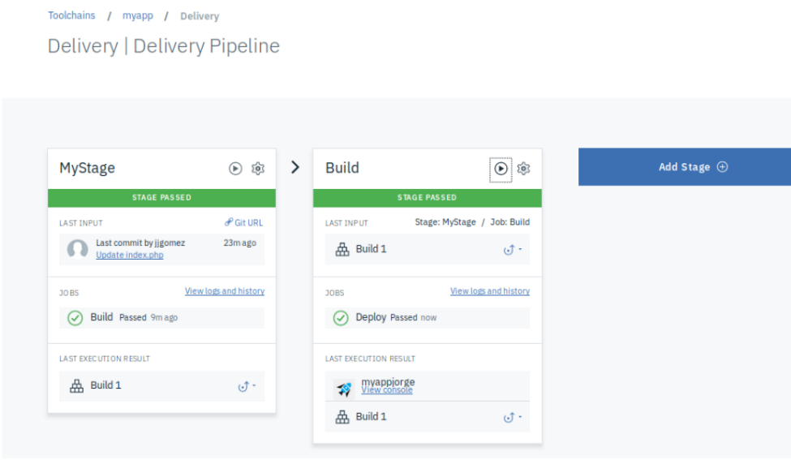
Introduction PaaS and IaaS
APP development with IBM Cloud
In order to make the changes visible, it is necessary to activate the delivery pipeline as in image 1.

Slide 18
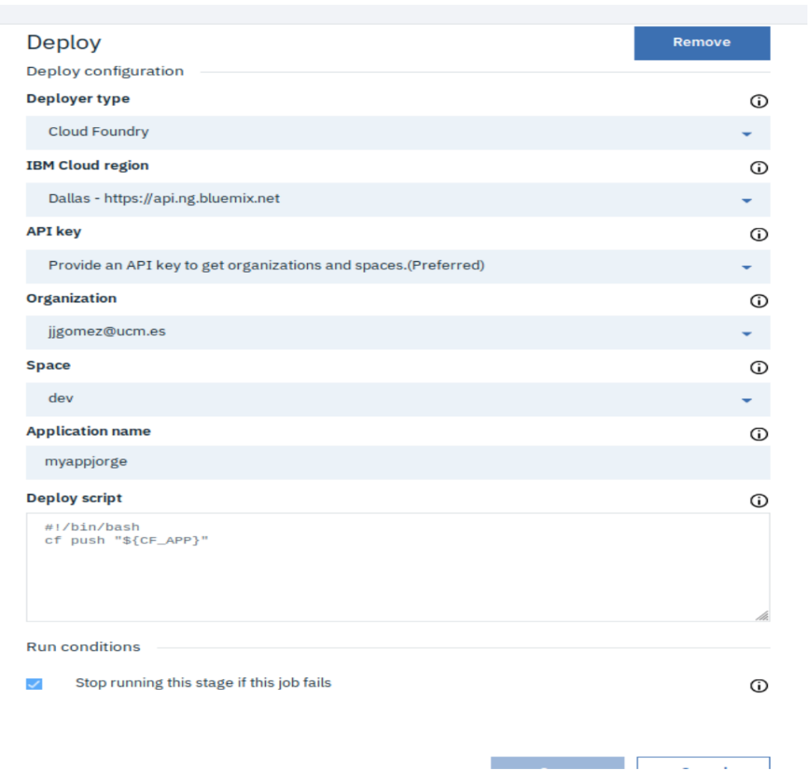
Introduction PaaS and IaaS
APP development with IBM Cloud
It may fail if the parameters are not the same. The application name must match the host name.
Troubleshooting:
messages with "the route... is already in user". The namespace "dev" and the same first name as the host name must be chosen in the delivery.
I can't see the changes in the URL that IBM gave me. Verify that you have made changes to the git repository and that you went through the pipeline.
The changes are not appearing. Try refreshing the web page where you view the application. It may change over time for a while.

